Slide 1
TECHNOLOGY

Slide 2
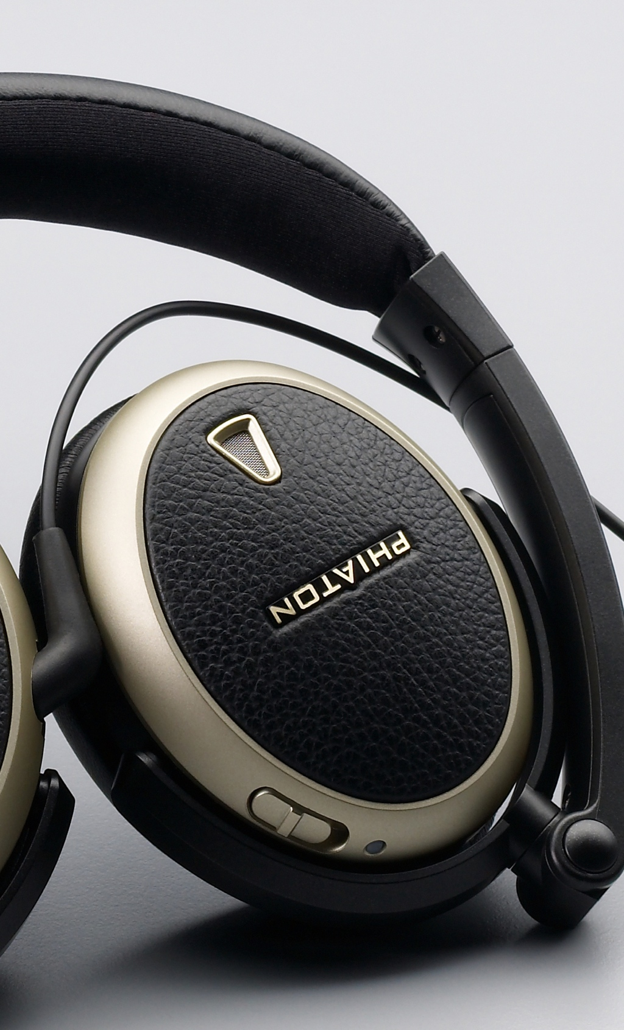
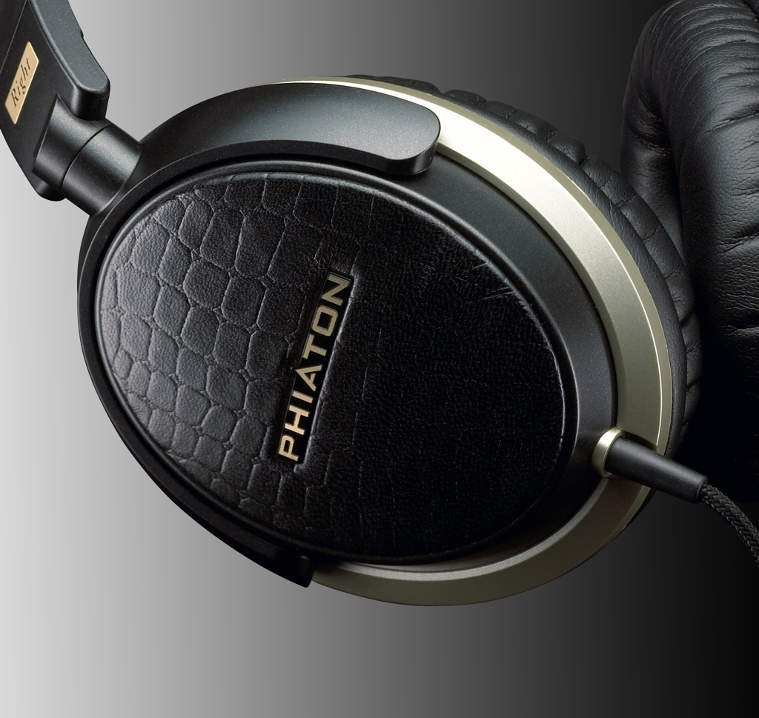
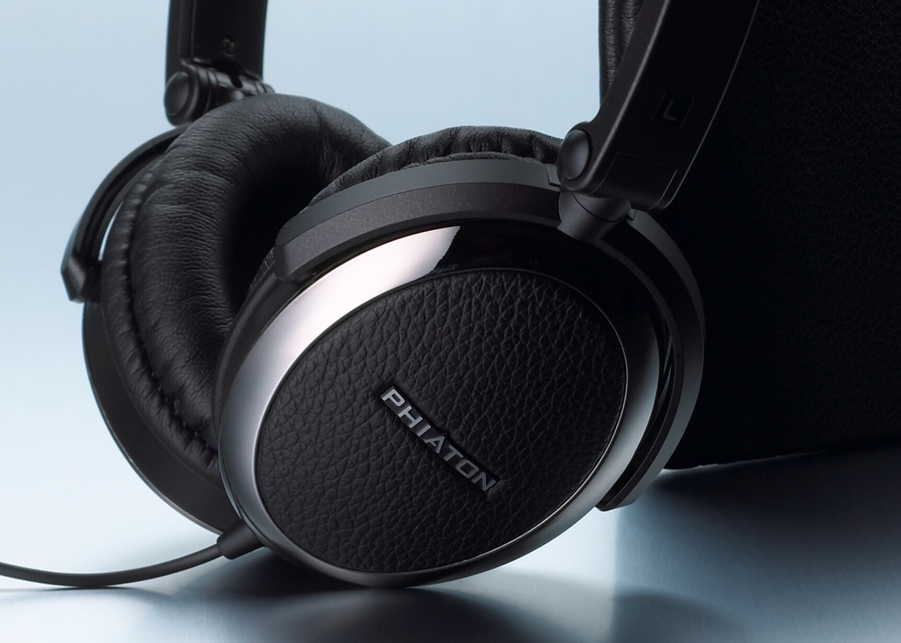
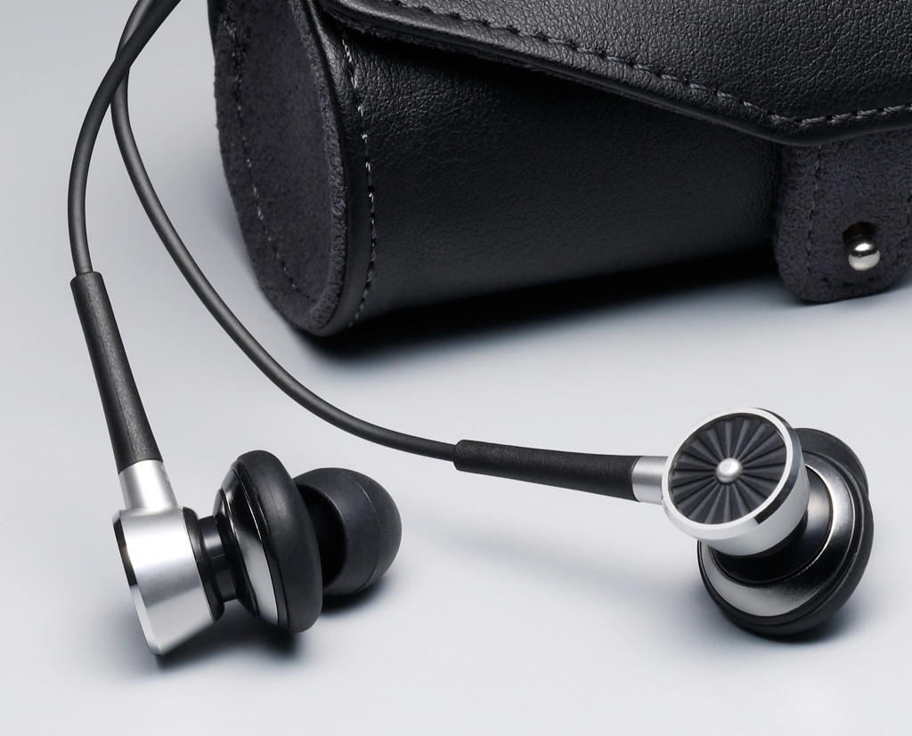
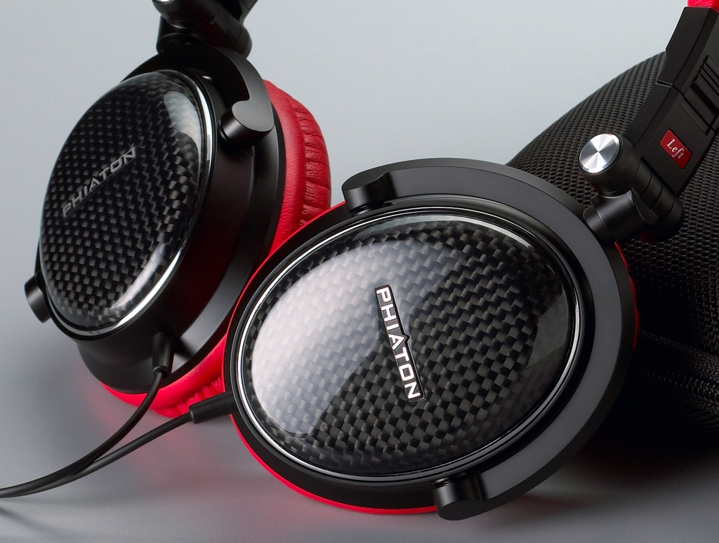
Material
Structure
Performance
Diaphragm
Function

Slide 3
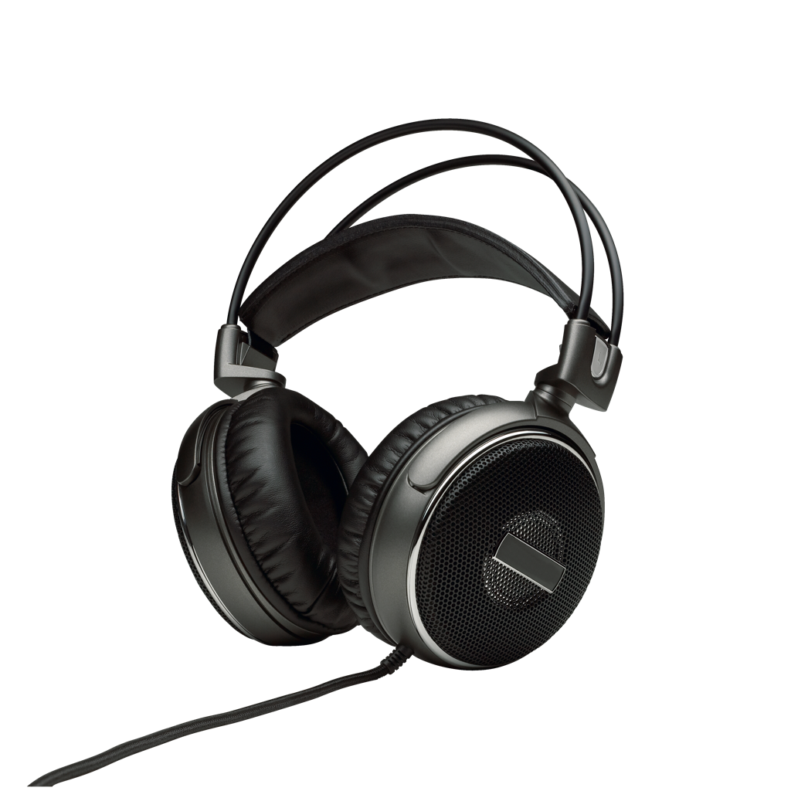
Material
Plastic
Plastic
?
Wood
Wood
Steel
Steel

Slide 4
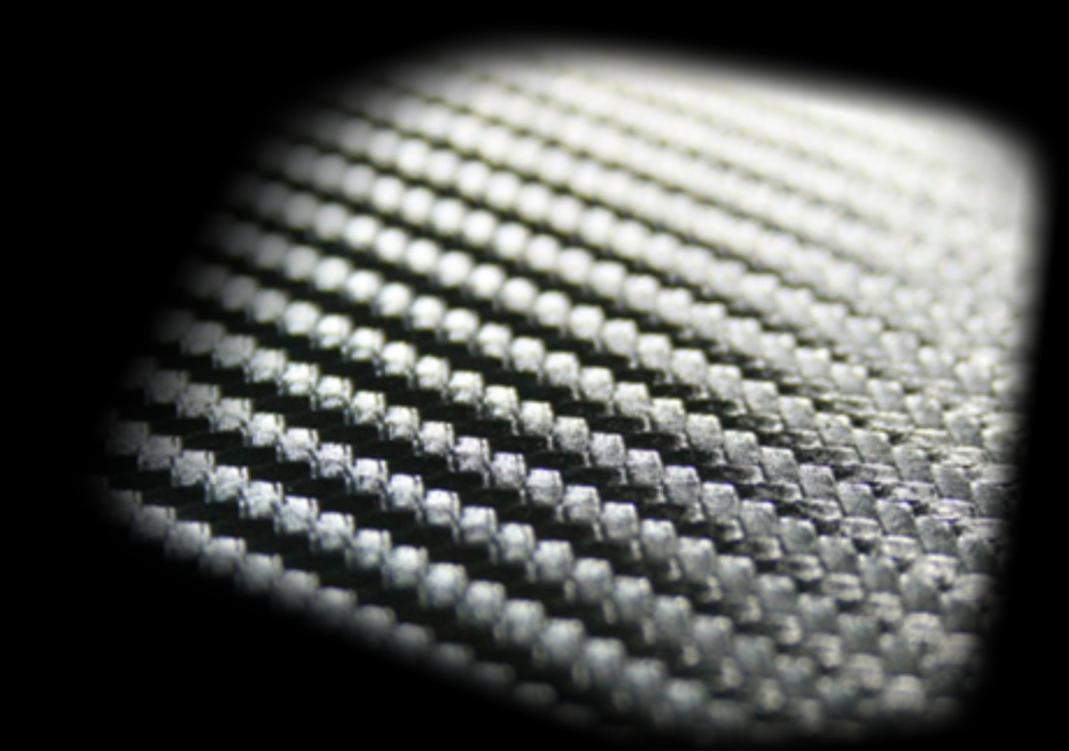
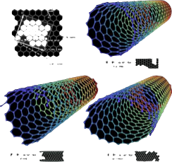
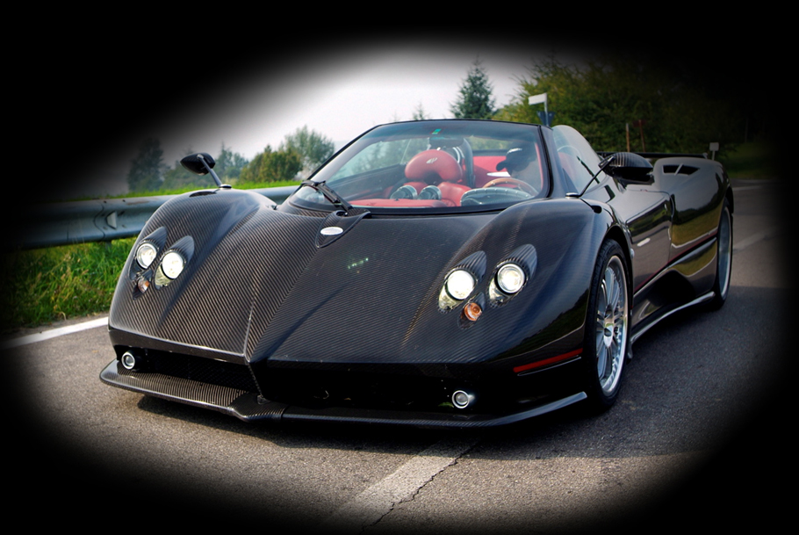
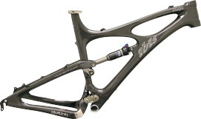
Carbon Graphite Fiber
Strong
Light weight
Handmade

Slide 5
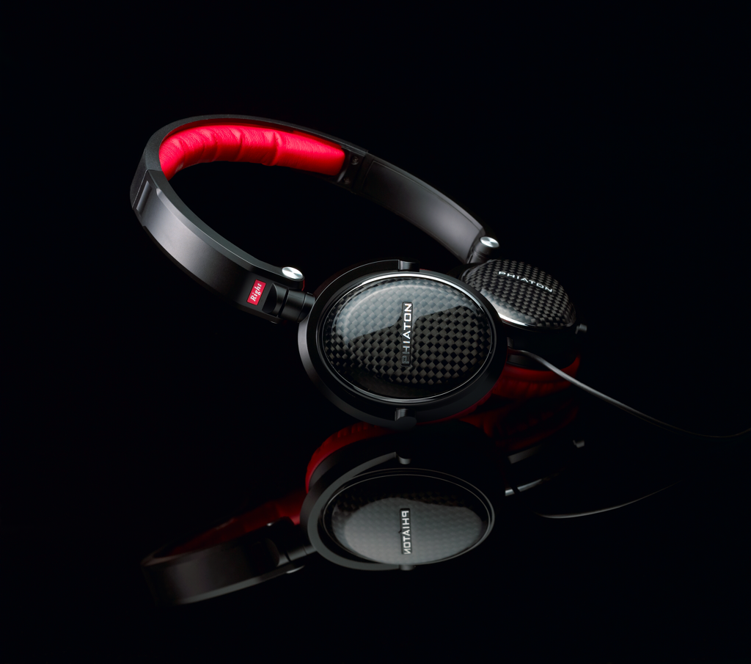
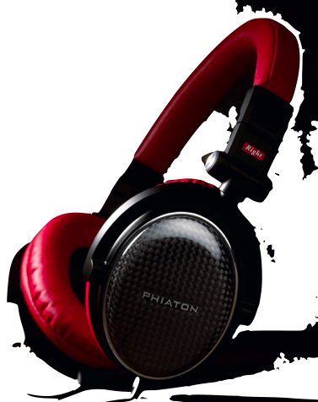
MS 300
MS 400
Real Carbon Graphite Fiber Enclosure

Slide 6
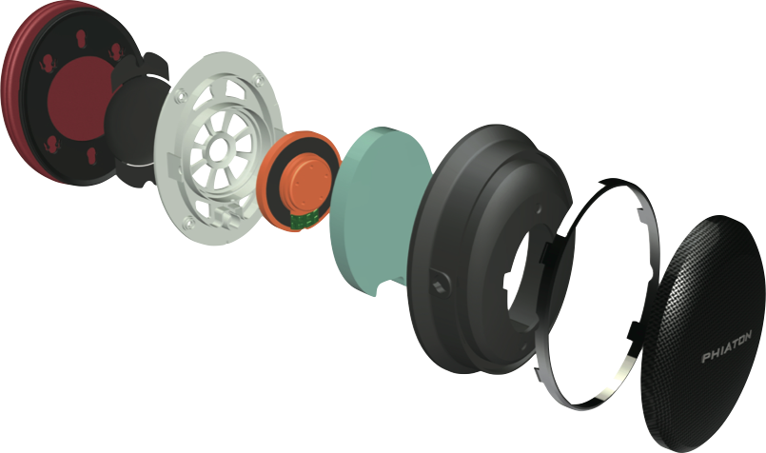
Carbon Graphite Fiber Enclosure
• Carbon graphite fiber enclosure for high quality audio• Optimized airflow delivers concert hall sound quality

Slide 7
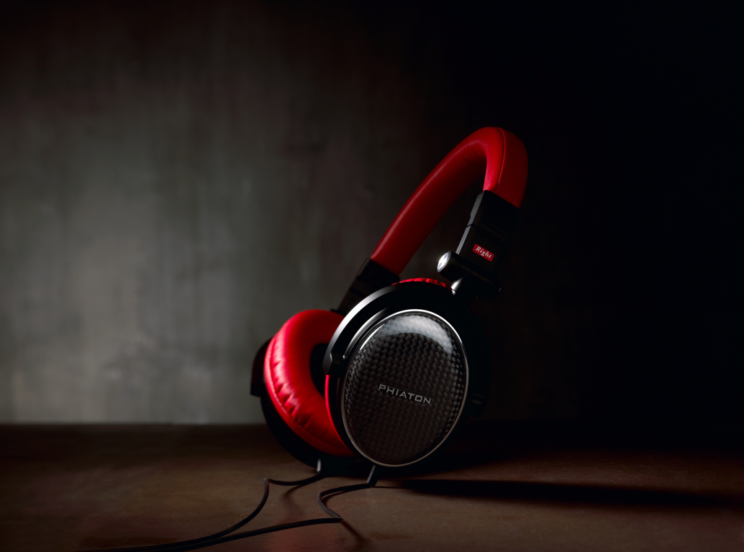
MS 400
“SOUND QUALITY IS A MUST,A ND THE
PHIATON MS 400 HEADPHONES DELIVER”
- JASMINE FRANCE, CNET.COM (2008)
WINNER AT THE
“INTERNATIONAL DESIGN AWARD 2009”
“PAIR OF HEADPHONES THAT COMBINE POWER
AND FIDELITY WITH A SWEET LOOKING DESIGN.”
- KYLE ANDERSON, ROLLINGSTONE (2008)

Slide 8
MS 300

Slide 9
Structure
Dual Chamber
damping and time delay
2nd Chamber
1st Chamber

Slide 10
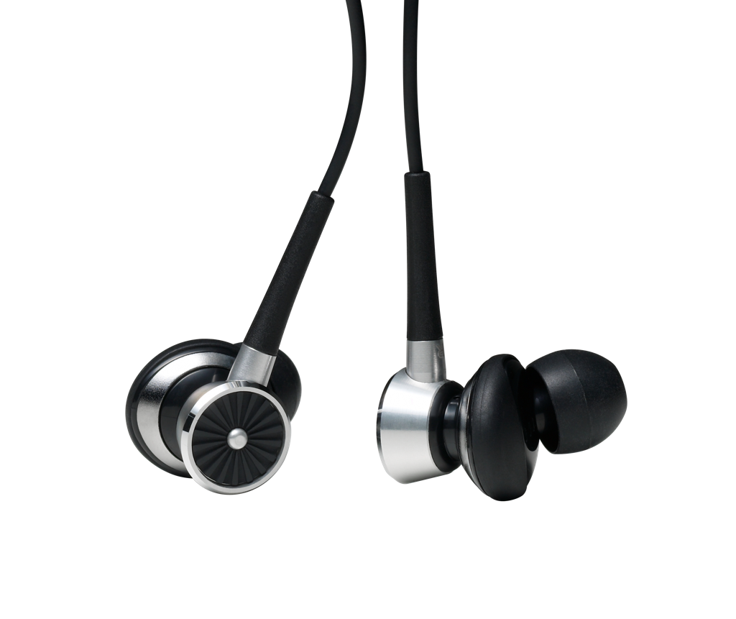
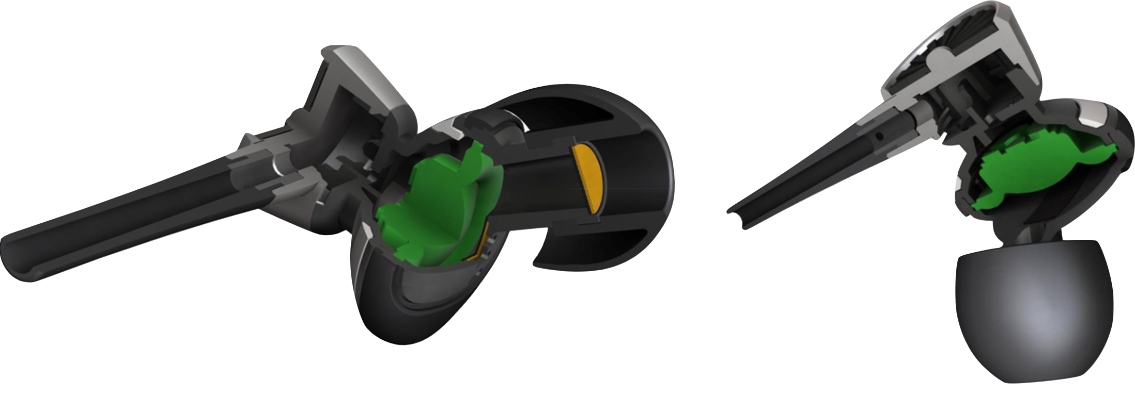
PS 210
Dual Chamber
Air flow by Dual Chamber

Slide 11
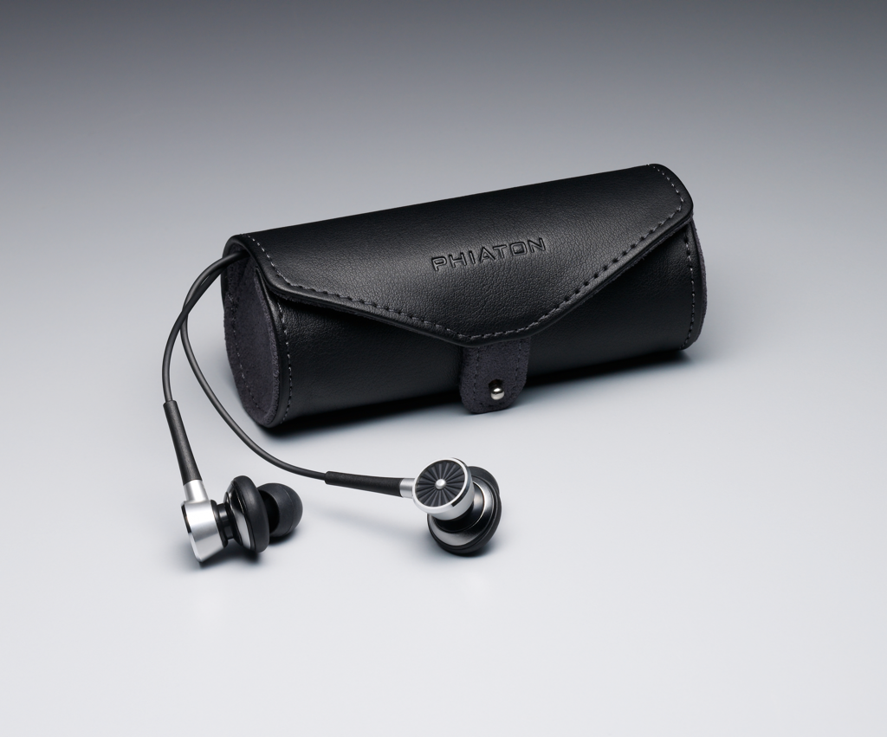
PS 210
“THE PHIATON PS 210 EARPHONES HAVE
A UNIQUE AND STYLISH DESIGN, AND THEY
PROVIDE CLEAR, BALANCED AUDIO. THE
PACKAGE INCLUDES A NICE LEATHER CASE.”
- JASMINE FRANCE, CNET.COM (2010)

Slide 12
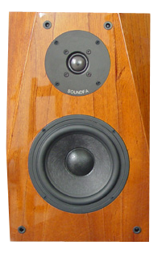
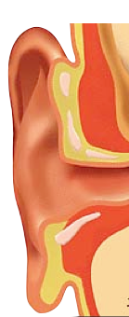
Function
Tweeter
Middle & Woofer
Normal Dual Speaker Type

Slide 13
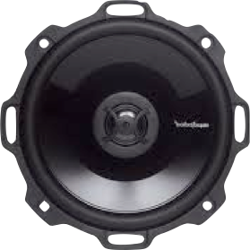
Tweeter
Middle & Woofer
Coaxial Dual Speaker Type

Slide 14
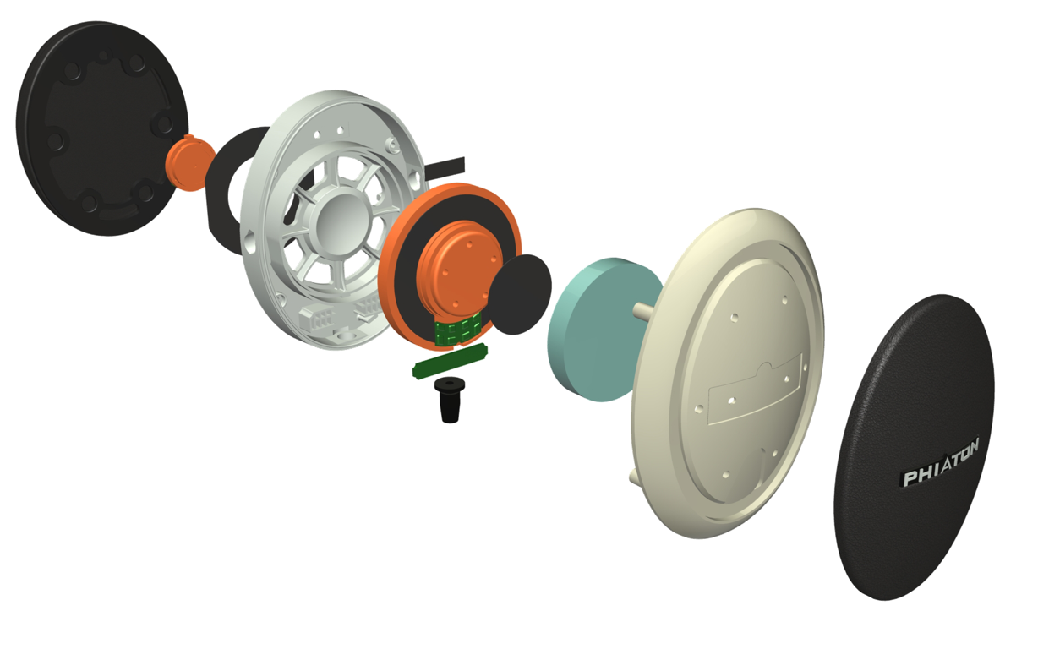
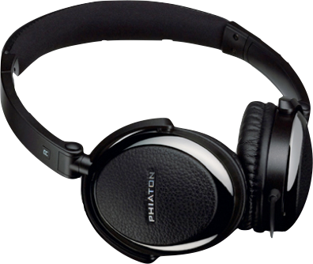
PS 320
Coaxial Dual Speaker
Tweeter speaker
Middle & Woofer speaker
Coaxial

Slide 15
Sound Pressure Level Graph
Single Speaker Headphones
Coaxial Dual Speaker Headphones

Slide 16
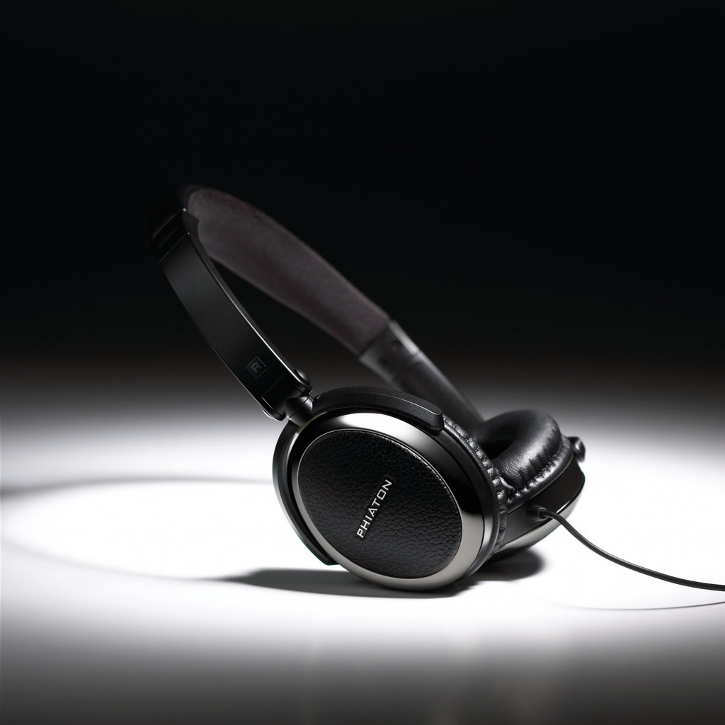
PS 320
“PS 320 DELIVERED AMAZING CLARITY, EVEN WITH
EVER-SHUFFLING ARRAY OF DIFFERENT LISTENING MATERIAL.”
- AUDIOFILE, OFF LINE MAGAZINE FOR AUDIO BOOKS (2010)
“I FIND THIS PERSONAL HEADPHONES TO BE SORT
OF A ‘GODSEND’.” - KEN UTTERBACK, EXAMINER.COM (2009)

Slide 17
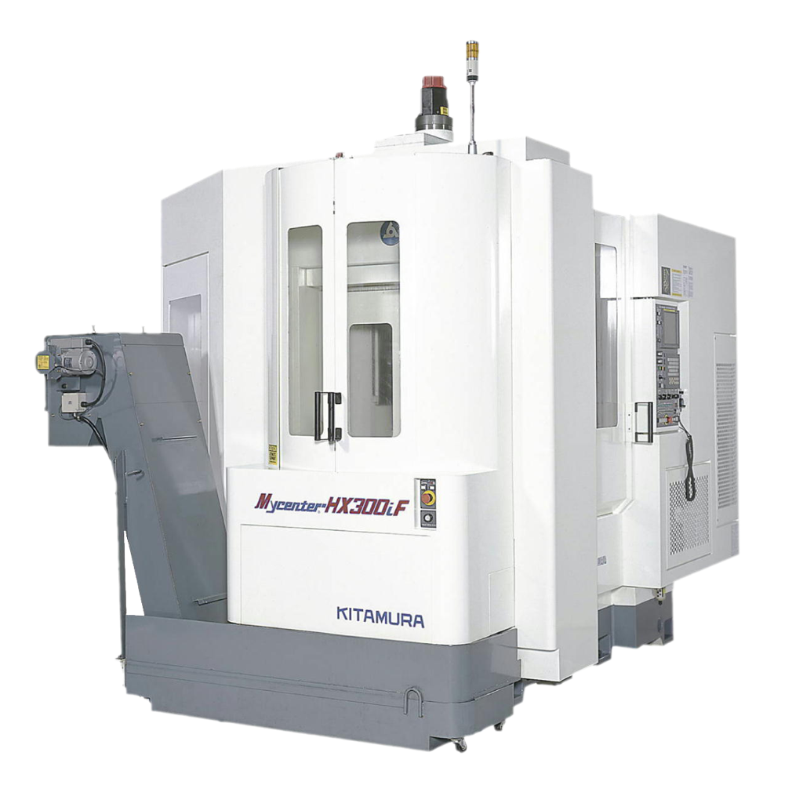
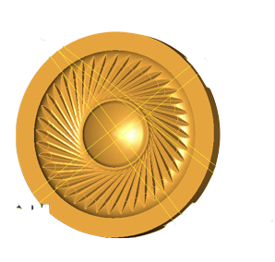
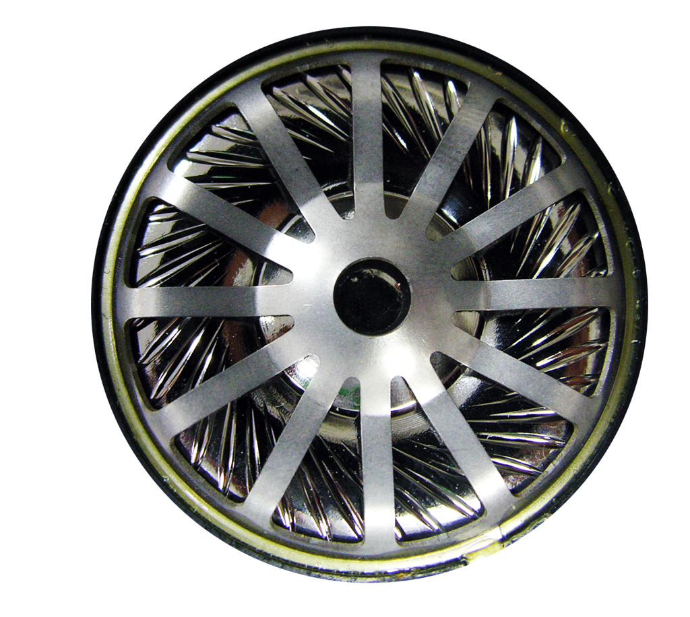
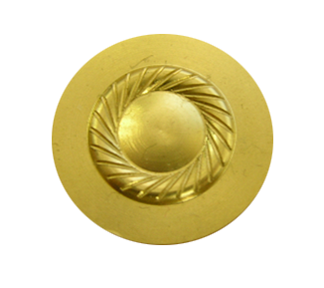
Diaphragm
3D modeling
CNC Machine
Titanium Vaporized Diaphragm Speaker
Diaphragm Mold

Slide 18
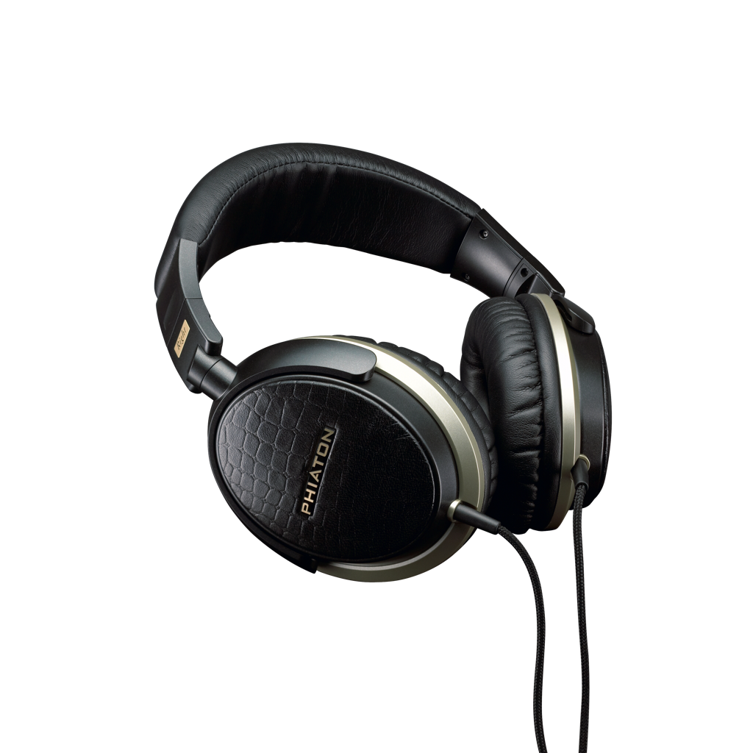
PS 500
• Clarity and dynamic range at the preferred listening volume• Optimized airflow delivers concert hall sound quality• Titanium Vaporized Diaphragm
Titanium Atomic Vaporized
Diaphragm

Slide 19
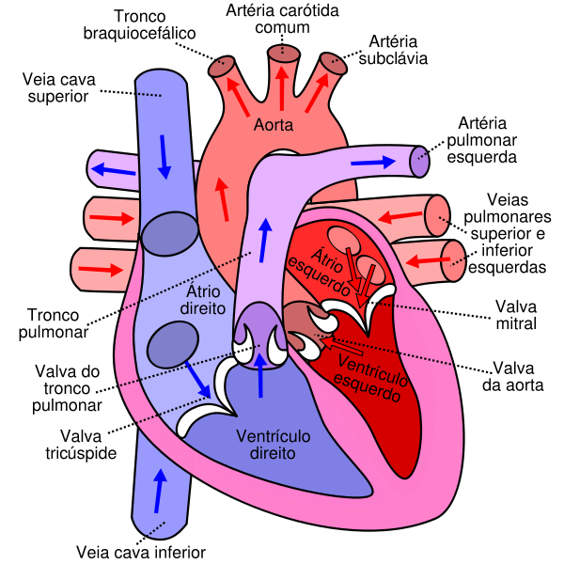
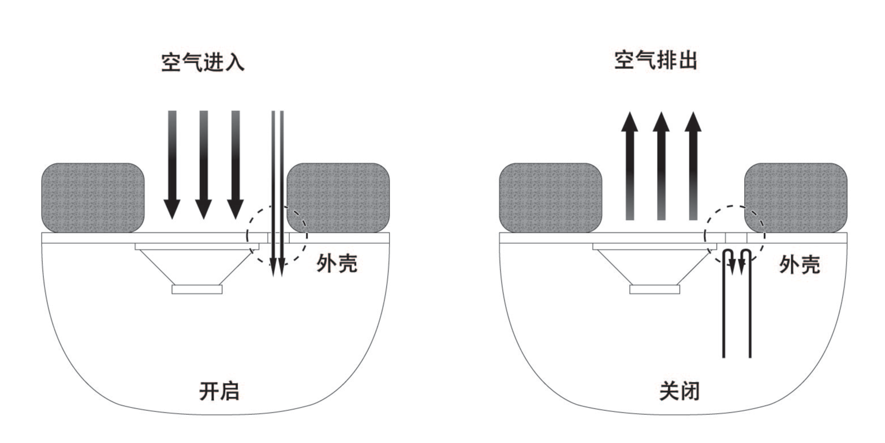
Function
VHST
( Valve of Heart Sound Technology )

Slide 20
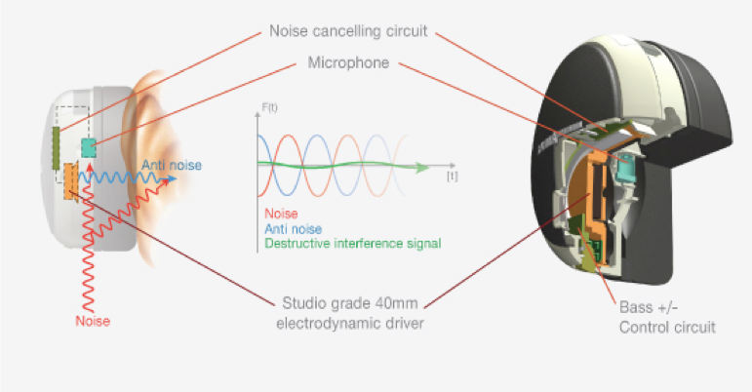
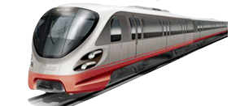
Active Noise Cancelling

Slide 21
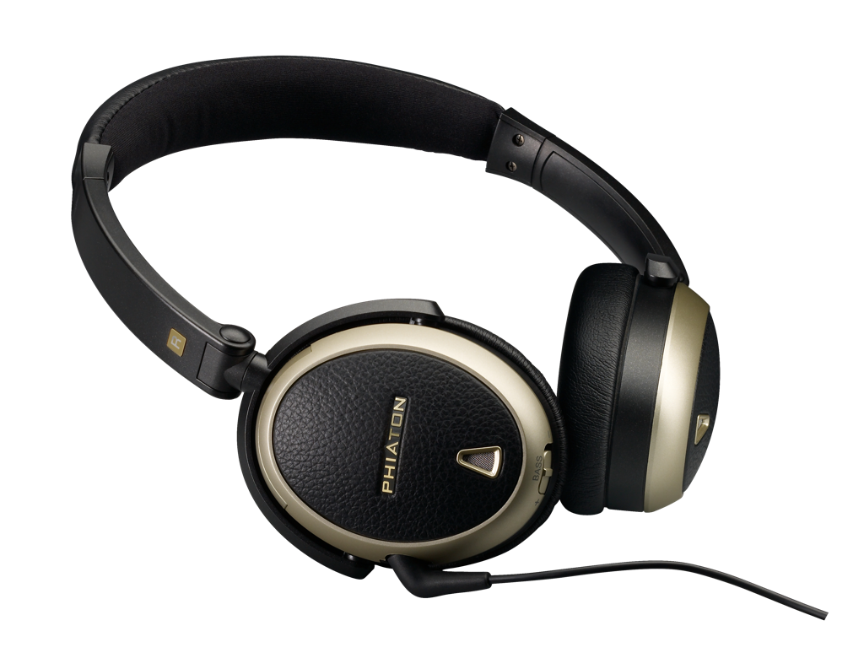
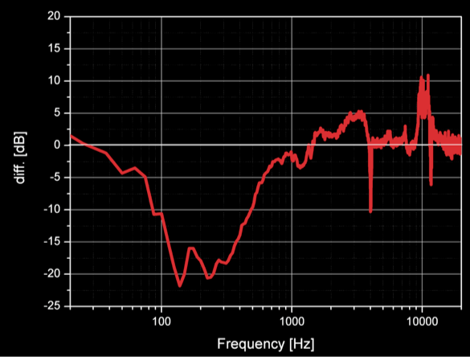
PS 300 NC
• Phiaton VHST™ Valves of the Heart Sound Technology for superior airflow control • Adaptive acoustic impedance control for better sound at any mode (NC on/off) • Finely tuned frequency balance and soft bass response• Rechargeable battery provide NC mode for 18 hours per charge

Slide 22
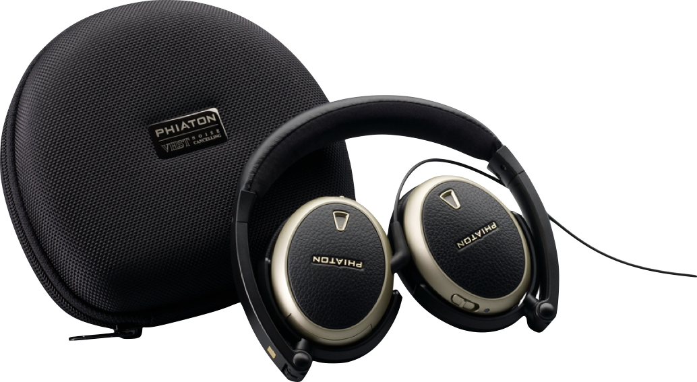
PS 300 NC
“THE HEADSET OF THE GODS.”
“THE PS 300 NC NOISE CANCELLING
HEADSET IS A MODERN WONDER.”
“THIS IS THE HEADSET FOR WHICH
WE’VE BEEN WAITING FOR ALL OUR LIVES.”
-JOEL DURHAM, EXTREMETECH.COM (2009)

Slide 23
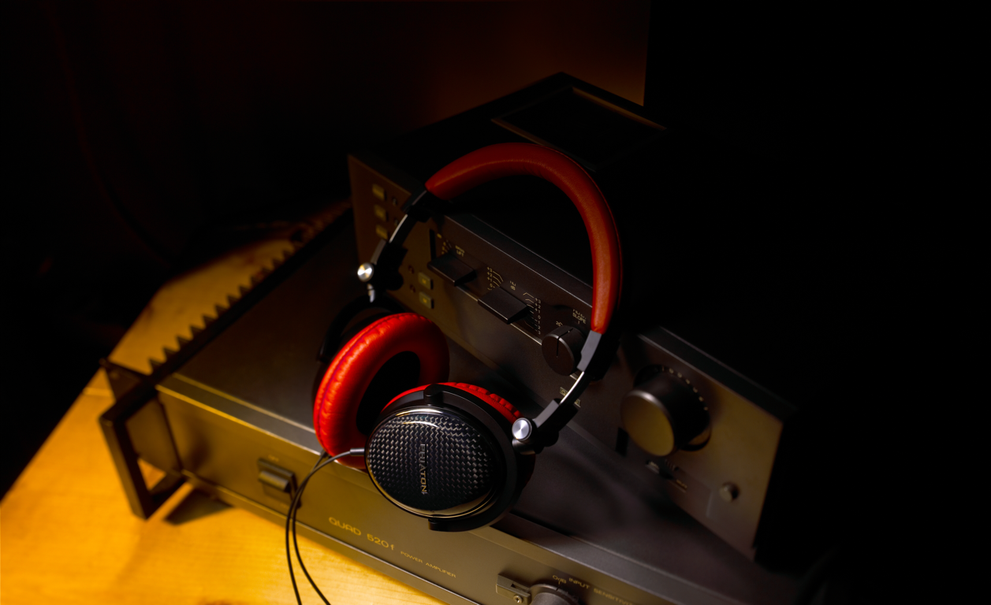
Since 1959

Slide 24
斐雅通
中國音质的标准

